Slide 1
Coilover Damping Adjusters
Started: 8/10/2022

Slide 2
High Level Block Diagram (old) – 8/10/2022
Main Control Board
Stepper Motor Board
Stepper Motor Board
IIC Slave
IIC Slave
OLED Display
Stepper Motor and Driver
IIC Master for communicating with motors
Stepper Motor and Driver
Encoder for Motor Position Feedback
Encoder for user input
Encoder for Motor Position Feedback
Stepper Motor Board
Stepper Motor Board
IIC Slave
IIC Slave
Stepper Motor and Driver
Stepper Motor and Driver
*Notes
IIC daisy chained to minimize the amount of wire.
Encoder for Motor Position Feedback
Encoder for Motor Position Feedback

Slide 3
Motor Control Board Block Diagram – 8/13/22
IIC Master
ATtiny3217
or
AVR32DA32
DRV8825
NEMA-17 Short Stepper Motor
Bours open-center encoder
Coilover Damping Adjustment Screw

Slide 4
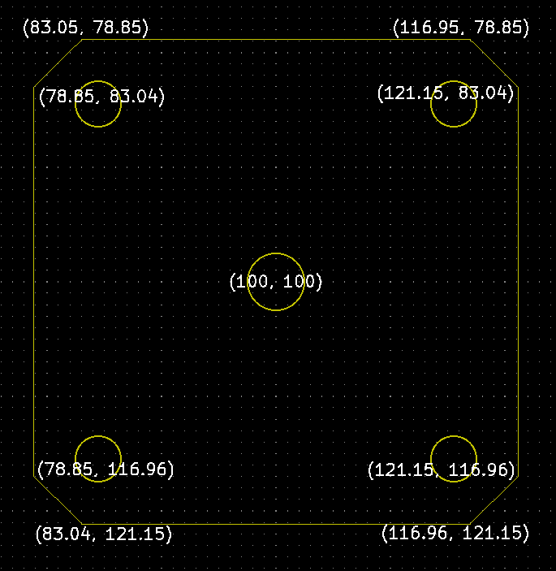
PCB Board Cutout Coordinates – 8/19/22
Coordinates of each corner relative to origin (100, 100)
(100,100)

Slide 5
Controller Board Block Diagram
Serial EEPROM
8-bit parallel interface
Stepper Motor Boards
240x320
LCD
ST7789
or variant
ATUC128D3
or
SAM4LC2BA
FL
FR
RL
RR
Switches

Slide 6
High Level Block Diagram Updated – 9/22/22
Main Controller
Operated by driver
Stepper Motor Board Front Right
Stepper Motor Board Rear Right
LCD Display
IIC Master for communicating with motors
IIC Slave
IIC Slave
Stepper Motor and Driver
Stepper Motor and Driver
Switches for user input
Encoder for Motor Position Feedback
Encoder for Motor Position Feedback
12V
Stepper Motor Board Front Left
Stepper Motor Board Rear Left
Power Board
Located by fuse box.
4x Connectors for power and communication.
IIC Slave
IIC Slave
Stepper Motor and Driver
Stepper Motor and Driver
Encoder for Motor Position Feedback
Encoder for Motor Position Feedback
GND

Slide 7
Top of Strut Dimensions and Actuator Depth – 10/9/22
Optimal length for hex key: 20.5mm from start of mounting (female) threads.

Slide 8
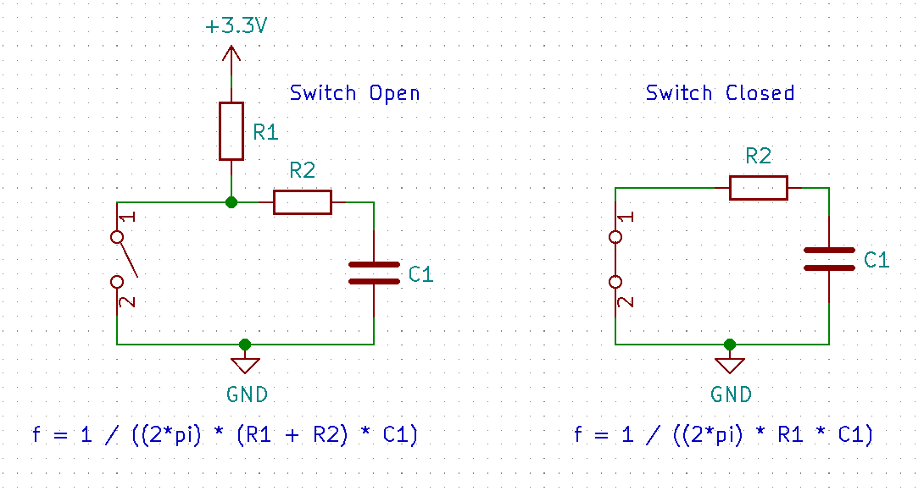
Encoder Filtering – 8/14/22
Encoder max current rating: 10mA @ 5v
Pull-up resistor for 10mA @ 3.3V: >=330 ohm
Max stepper RPM: ~100 rpm
Encoder pulses per rotation (PPR): 10
Pulses per second: 16.67
Min cutoff frequency: 16.67 Hz
R1 = 330
R2 = 7.5k
C1 = 1u
F_{c_open} = 20.32 Hz
F_{c_closed} = 21.22 Hz
If R2 = 5.1k
F_{c_open} = 29.31 Hz
F_{c_closed} = 31.21 Hz

Slide 9
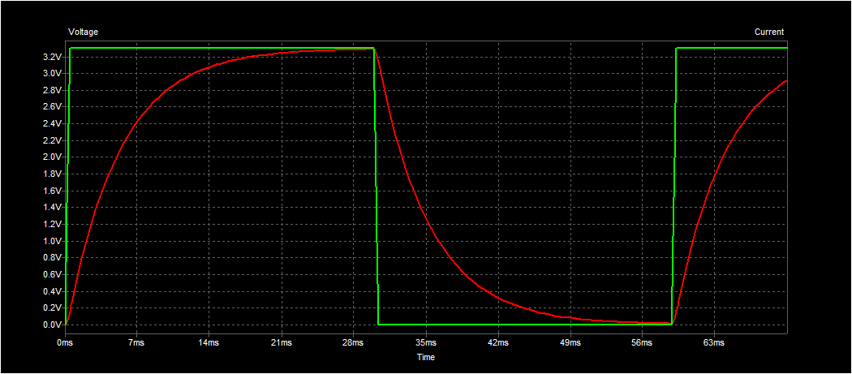
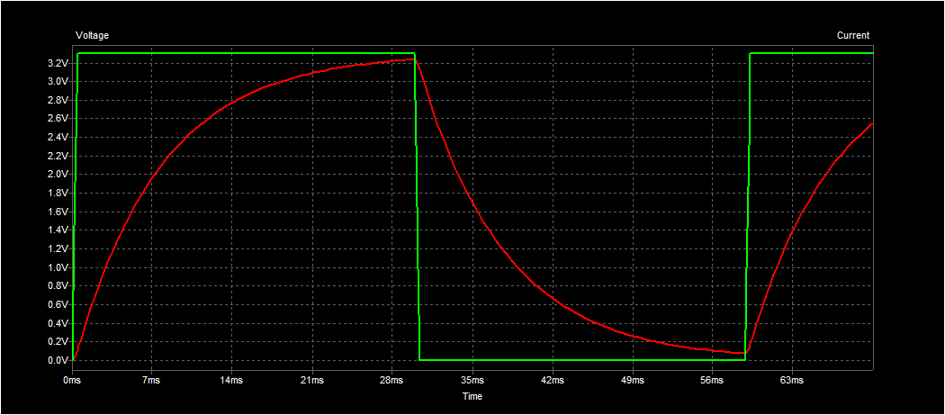
Encoder Filtering Cont – 8/15/22
Schmitt trigger max upper threshold @ 3V: 2.0V
Schmitt trigger min lower threshold @ 3V: 0.8V
RC filter output with R2 = 5.1k
RC Filter output with R2 = 7.5k

Slide 10
Stepper Current Sense Loop – 8/19/22
ATtiny32xx DAC output range: 0.2 to VDD-0.2
AVR32 DAC output range: GND to VDD
DVR8825 V_{ref} absolute range: 0V – 3.5V
Recommended range: 1V – 3.5V
R_{sense}: 0.1 ohm
V_{ref} for 1A I_{chop}: 0.5V
R_{sense} power dissipation: 0.1W
R_{sense}: 0.25 ohm
V_{ref} for 1A I_{chop}: 1.26V
R_{sense} power dissipation: 0.251W

Slide 11
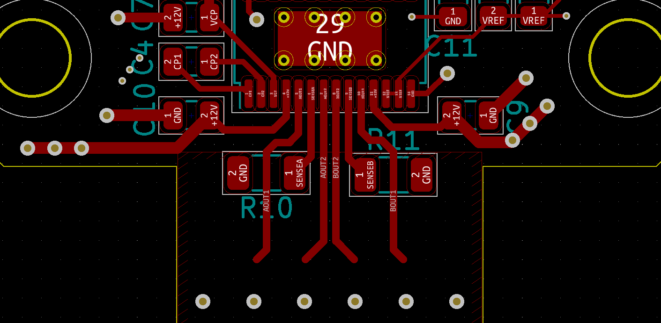
Stepper Motor Current Loop – 8/21/22
Goal is to keep current loop as short and constrained as possible.
Peak current of 1A per coil

Slide 12
On-Board Voltage Measurements – 8/21/22
V_{ref} = 2.5V
Battery Voltage
Max battery voltage: 15V
Min battery voltage: 11V
R1 = 1200, R2 = 200 -> divide by 7
Max power = 160.7mW
Max divider output = 2.143V = 3511 (12 bit output)
Min divider output = 1.571V = 2574 (12 bit output)
Battery Voltage = ADC result / 1638.4
V_{ref} = 2.5V
Regulated Voltage
Max, hopefully, 3.3V
Min, because of V_{ref}, 2.5V
R1 = 680, R2 = 680 -> divide by 2
Max power = 165.4mW
Max divider output = 1.65V = 2703 bits
Min divider output = 1.25V = 2048 bits
Regulated Voltage = ADC result / 1638.4

Slide 13

On-Board Voltage Measurements – 9/1/22
Calculating minimum impedance divider while not exceeding resistor power rating (0.25W)

Slide 14





Slide 15
Mounting – 8/26/22
Coilover top hat thread size M12x1.25

Slide 16
Controller MCU Selection – 8/29/22
Device/Description | # of pins
LCD data pins | 8
LCD backlight | 1
LCD Data/Cmd, CS, RD, WR | 4
LCD reset | 1
At least 1 IIC | 2
Buttons | >=5
Total | >=21 + prog pins
Minimum memory:
Absolutely no less than 128kB, ideally more than or equal to 256kB.
Peripherals:
At least 1 IIC.
CANBUS for future use.
EMI/SBC?
ATSAM4LC2BA

Slide 17
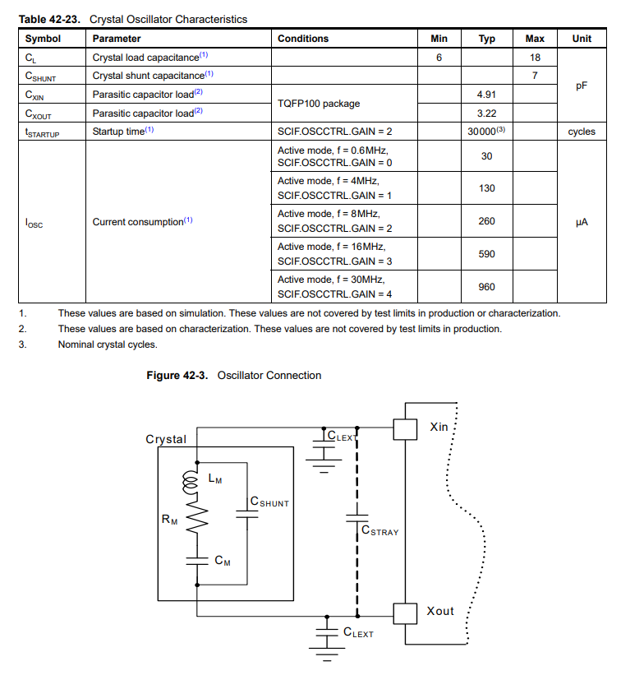
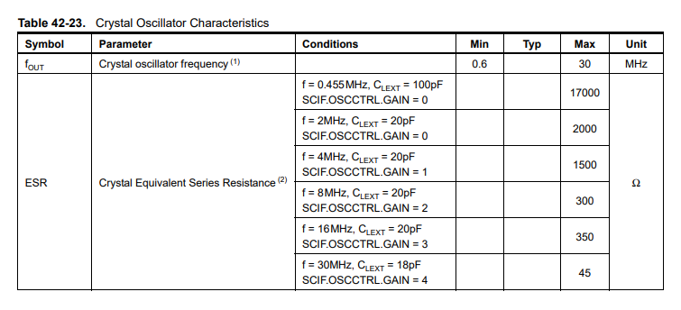

ATSAM4LC2BA Clocking – 9/1/22
Crystal: AS-30.000-10-F-2020-EXT-SMD-TR
External capacitor value =
C_{x} = 2(C_{L} – C_{stray}) = 2(10pF – 3pF) = 14pF

Slide 18
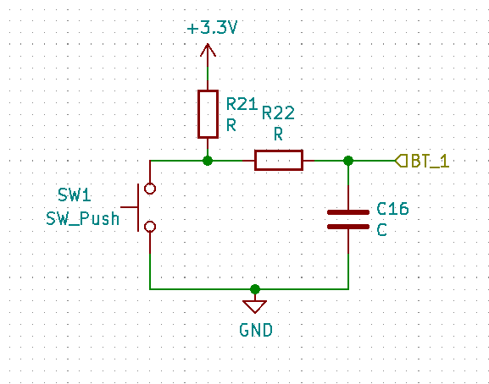
Controller Board Buttons Filter – 9/2/22
Max current through button: 10mA
Pull resistor (R21): 3.3V / 10mA = 330 ohm
Cutoff frequency minimum: 15Hz
f_{c,min} = 1 / ((2*pi)*(R21+R22)*C16)
C16: 1uF
R21: 330
R22: 10k
Switch pressed cutoff frequency = 15.92Hz
Switch released cutoff frequency = 15.41Hz

Slide 19
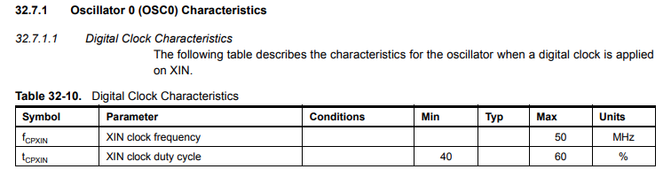
ATUC128D3 Clocking – 9/3/22

Slide 20
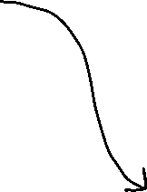
DRV8825 Step PWM Frequency Calculation – 9/15/22

Slide 21






Stepper Motor Timeout Frequency Calculations – 10/7/2022

Slide 22
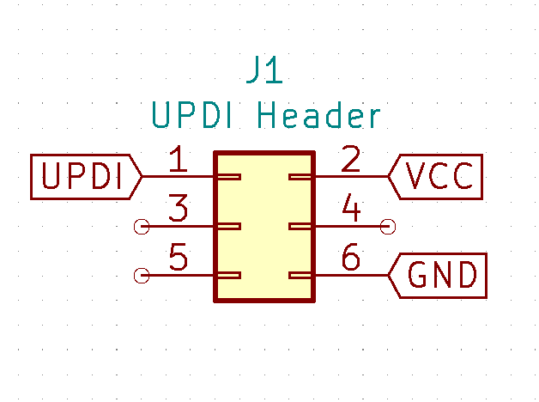
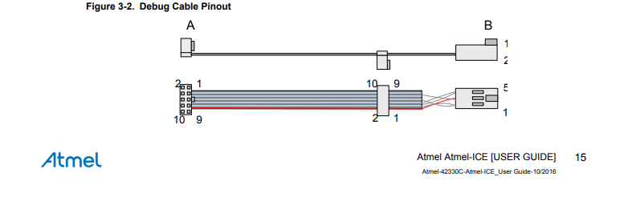
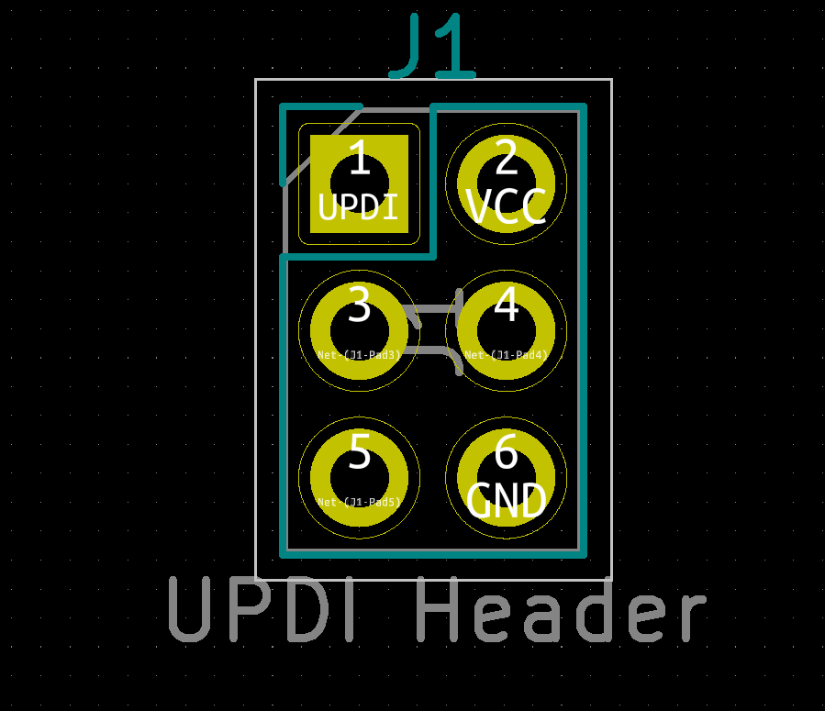
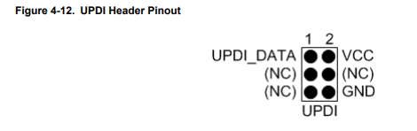
UPDI Pinout – 8/13/22
Atmel ICE Pinout
My Pinout

Slide 23
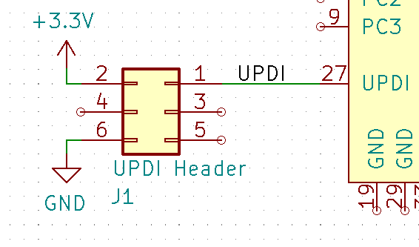
UPDI Pinout - 8/20/22
Updated schematic for AVR32DA32

Slide 24
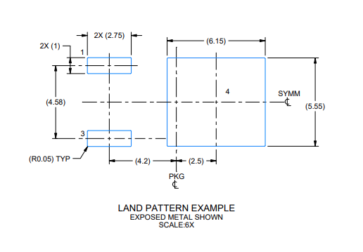
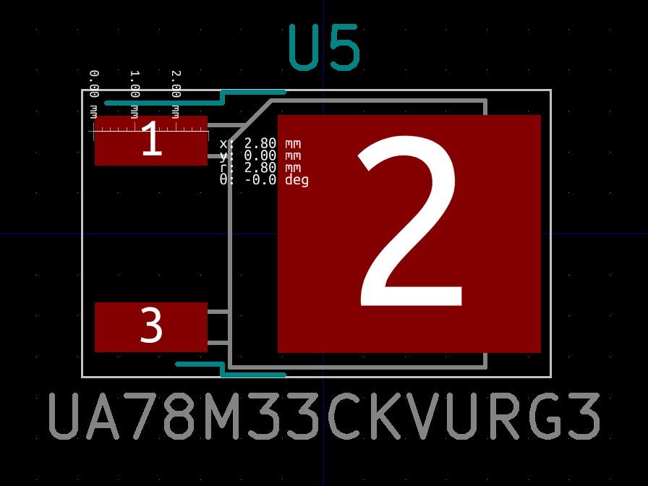
UA78M33CKVURG3 Footprint – 8/15/22
Had to modify existing KiCAD TO-252 footprint. Extended pin 1 & 3 pads to 2.75mm from 2.2mm.

Slide 25
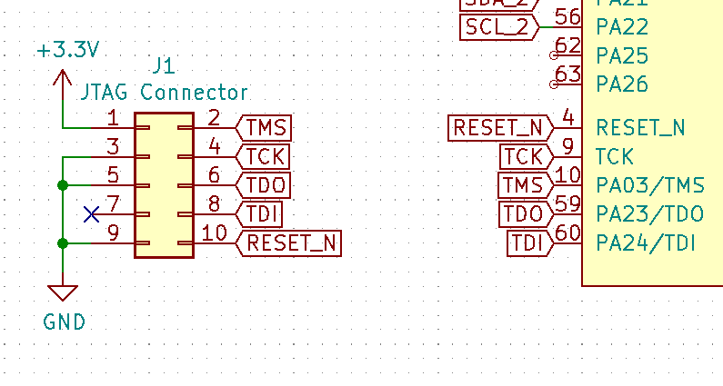
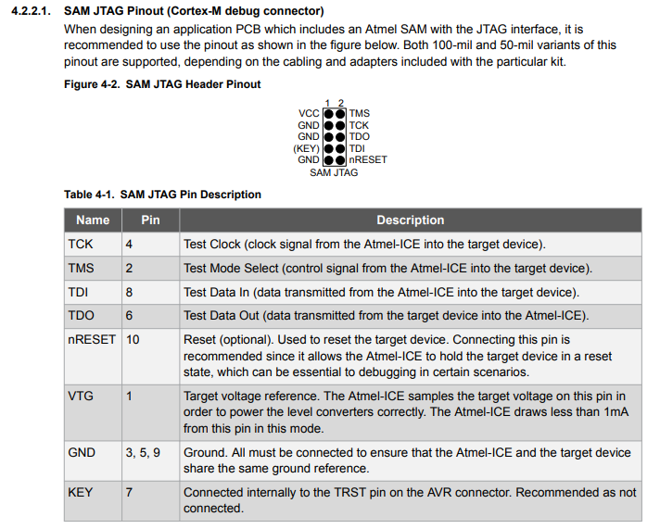
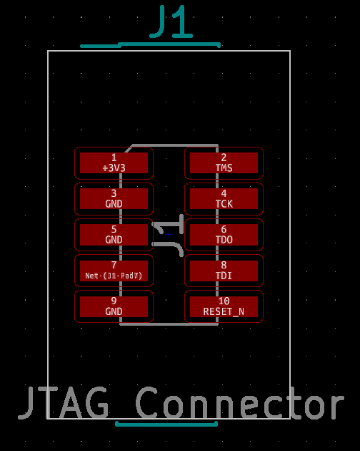
ATSAM4LC2BA JTAG Pinout – 8/30/22

Slide 26
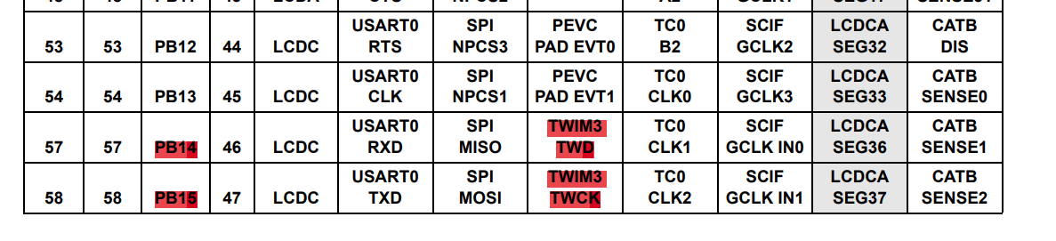
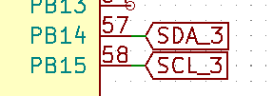
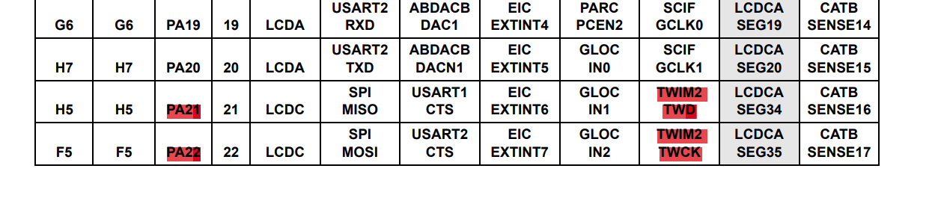
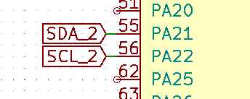
ATSAM4LC2BA I2C Pins – 8/31/22

Slide 27
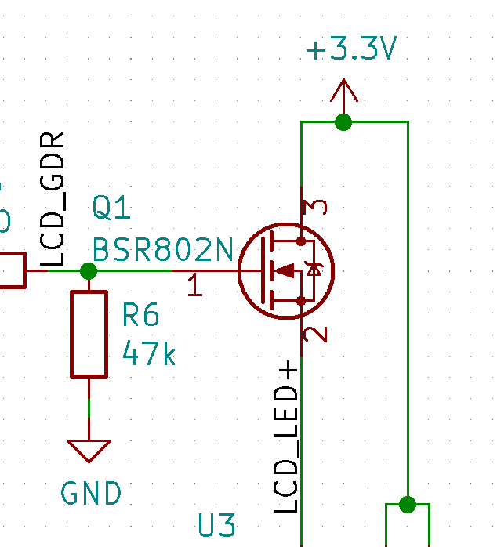
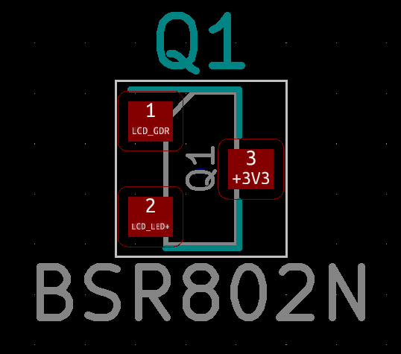
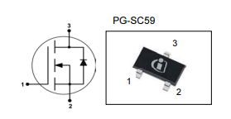
BSR802N Backlight FET Pinout – 9/1/22
Datasheet

Slide 28
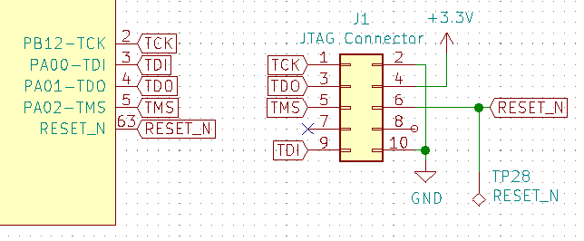
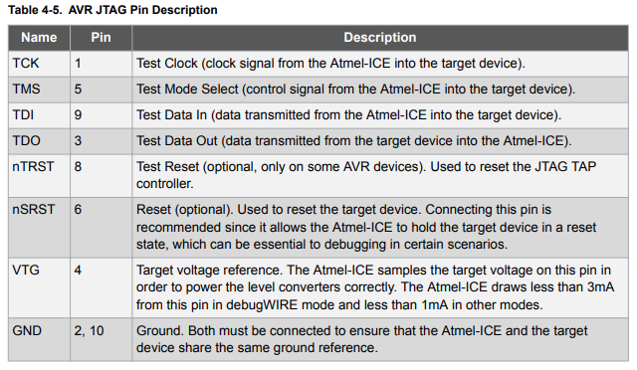
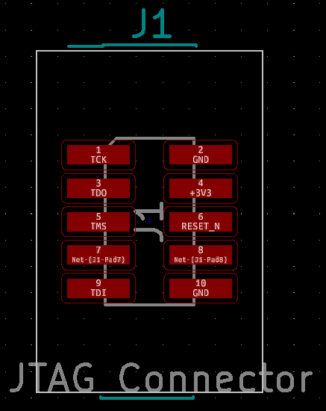
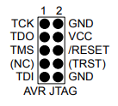
ATUC128C3 JTAG Pinout – 9/3/22

Slide 29

SN74LVC2G17 Decoupling – 8/15/22

Slide 30
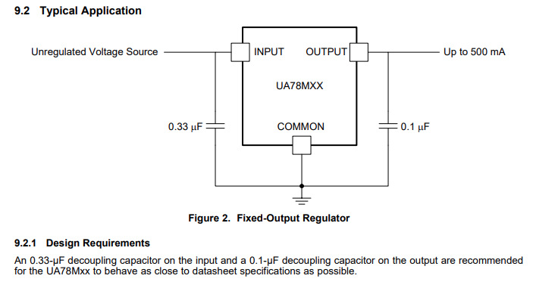
UA78M33CKVURG3 Decoupling – 8/17/22

Slide 31
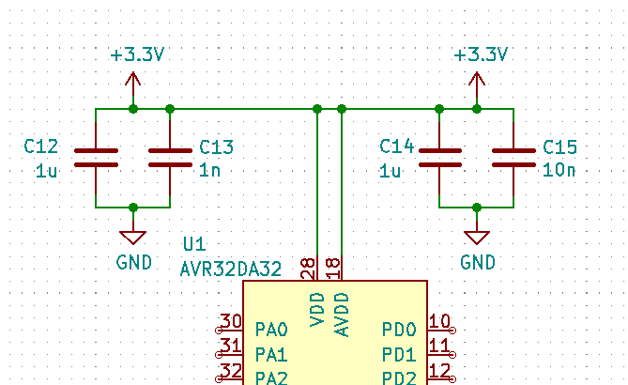
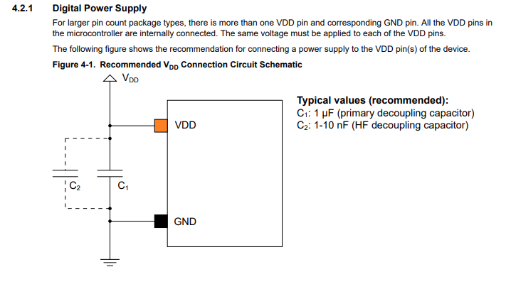
AVR32DA32 Decoupling

Slide 32
ATSAM4LC2BA Power Supply – 8/30/22
VDDANA, GNDANA
Analog Voltage Supply,
3.3V
VDDCORE
Core voltage supply
1.8V, connect to VDDOUT
VDDIN
Voltage regulator in
3.3V
VDDIO
IO Voltage,
3.3V,
VDDOUT
Voltage regulator output
1.8V out

